Slide 1
Przetwarzanie multimediów w systemach decyzyjnych
“IoT jak źródło danych do zastosowań ML/AI - wsparcie rozwiązań chmurowych”
Arkadiusz Harasimiuk
Katedra Systemów Multimedialnych,
WETI

Slide 2
IoT jak źródło danych do zastosowań ML/AI - wsparcie rozwiązań chmurowych
Agenda:
IoT - podstawowe pojęcia
Google IoT Core
Notes:
What is the Internet of Things (IoT)?
Broadly speaking, the Internet of Things (IoT) encompasses all physical objects - i.e. “things” - that connect to the internet and to other devices.
The definition of IoT is evolving, as the term is increasingly being used to describe objects that interact and “speak” to one another, so we can have the opportunity to be more efficient in how we do things.
More specifically, IoT devices are characterized by their ability to gather data on their surroundings, share this data with other electronic devices, and ultimately, help us, the end-user gain information, solve an issue, or complete a task.
To visualize the concept, think of a time you’ve gone to the restroom in a hotel, and the light has turned on by itself. Ever wonder how that happened? There is probably a motion detection sensor there that detects movement, which automates and connects to the light to turn it on.
This is only one of the simplest forms of an IoT solution, as the technology is now being used to create larger ecosystems such as smart homes and smart cities. If you read your emails through a voice-controlled virtual assistant, measure your steps and heartbeat with a smartwatch, or control your security system through your mobile phone, you’re benefiting from IoT solutions on a daily basis.

Slide 3
IoT jak źródło danych do zastosowań ML/AI - wsparcie rozwiązań chmurowych
Internet Rzeczy (IoT)
Internet rzeczy (IoT) obejmuje wszystkie obiekty fizyczne – tj. „rzeczy” – które łączą się z Internetem i innymi urządzeniami.
Urządzenia IoT charakteryzują się zdolnością do gromadzenia danych o swoim otoczeniu, udostępniania tych danych innym składowym rozwiązaniaoraz pomagają w uzyskaniu informacji, rozwiązaniu problemu lub wykonaniu zadania.
Notes:
What is the Internet of Things (IoT)?
Broadly speaking, the Internet of Things (IoT) encompasses all physical objects - i.e. “things” - that connect to the internet and to other devices.
The definition of IoT is evolving, as the term is increasingly being used to describe objects that interact and “speak” to one another, so we can have the opportunity to be more efficient in how we do things.
More specifically, IoT devices are characterized by their ability to gather data on their surroundings, share this data with other electronic devices, and ultimately, help us, the end-user gain information, solve an issue, or complete a task.
To visualize the concept, think of a time you’ve gone to the restroom in a hotel, and the light has turned on by itself. Ever wonder how that happened? There is probably a motion detection sensor there that detects movement, which automates and connects to the light to turn it on.
This is only one of the simplest forms of an IoT solution, as the technology is now being used to create larger ecosystems such as smart homes and smart cities. If you read your emails through a voice-controlled virtual assistant, measure your steps and heartbeat with a smartwatch, or control your security system through your mobile phone, you’re benefiting from IoT solutions on a daily basis.

Slide 4
IoT jak źródło danych do zastosowań ML/AI - wsparcie rozwiązań chmurowych
Historia Internetu Rzeczy (IoT)
Termin Internet of Things - zapoczątkowany przez Kevina Ashtona w 1999 roku, ale sięga wczesnych lat 80-tych i jest związany z maszyną Coca-Cola na Carnegie Mellon University.Grupa studentów z uniwersytetu zaprojektowała system, dzięki któremu kampusowy automat Coca-Cola zgłaszał zawartość, dzięki czemu mogli uniknąć kłopotów ze sprawdzaniem, czy w automacie nie ma Coca-Coli. Oprócz raportu z inwentaryzacji byli również w stanie sprawić, że maszyny powiadomią ich, czy nowo załadowane napoje są zimne, czy nie.
1990 - John Romkey - podłączył toster do Internetu. Niedługo potem inna grupa studentów z Uniwersytetu Cambridge użyła kamery internetowej do monitorowania ilości kawy dostępnej w ich laboratoriach komputerowych.
Notes:
The History of the Internet of Things (IoT)
The term Internet of Things was originated by Kevin Ashton in 1999, but the idea has been around for much longer and dates back to the early 80s with a Coca-Cola machine at Carnegie Mellon University.
A group of students from the university designed a system to get their campus Coca-Cola vending machine to report on its contents, so they could avoid the trouble of having to check if the machine was out of Coke. Aside from the inventory report, they were also able to make the machines let them know whether newly loaded drinks were cold or not.
Later, In 1990, John Romkey connected a toaster to the internet for the first time. Not long after, another group of students at the University of Cambridge used a web camera to monitor the amount of coffee available in their computer labs.
Then, finally, in 1999, the term Internet of Things was founded by Kevin Ashton during his presentation for Procter & Gamble, a multinational consumer goods corporation. When working there as a brand manager, Ashton had been assigned to help launch a line of cosmetics. He noticed that a specific shade of brown lipstick always seemed to be sold out, although many employees part of the supply chain would report that color as available in the warehouse. So, Ashton gave an “Internet of Things” presentation and suggested that each product has a radio frequency identification (RFID) tag that allows the identification and tracking of specific objects throughout the supply chain.
By the late 2000s to early 2010s, organizations around the world were starting to become really excited about the Internet of Things – similar to how they’re getting enthusiastic about AI and machine learning today. The International Business Machine (IBM) corporation started to work on a Smarter Planet program, McKinsey began publishing studies on the condition of the Internet of Things technology, and in 2011, Cisco announced that the IoT was “born” around 2008 and 2009 when more machines or objects were linked to the web than there were people on the earth.
The Internet of Things (IoT) was originally most interesting to business and industrial development, where its usage is often referred to as machine-to-machine (M2M), but the focus has shifted on filling our homes and workplaces with smart devices, bringing benefits to almost everyone. As of right now, there are as many as 35 billion IoT devices installed all over the world - and the prospect by the end of 2021 is that the number will reach 46 billion.

Slide 5
IoT jak źródło danych do zastosowań ML/AI - wsparcie rozwiązań chmurowych
Historia Internetu Rzeczy (IoT)
1999 - Kevin Ashton, podczas swojej prezentacji dla Procter & Gamble, międzynarodowej korporacji produkującej towary konsumpcyjne, ustanowił termin Internet Rzeczy.Jako brand manager został przydzielony do pomocy we wprowadzeniu na rynek linii kosmetyków. Zauważył, że określony odcień brązowej szminki zawsze wydawał się wyprzedany, chociaż wielu pracowników łańcucha dostaw zgłaszało, że ten kolor jest dostępny w magazynie. Ashton - przedstawił prezentację „Internet rzeczy” i zasugerował, że każdy produkt ma znacznik identyfikacji radiowej (RFID), który umożliwia identyfikację i śledzenie określonych obiektów w całym łańcuchu dostaw.
Internet rzeczy (IoT) był pierwotnie najbardziej interesujący dla rozwoju biznesu i przemysłu, gdzie jego wykorzystanie jest często określane jako machine-to-machine (M2M), ale skupiono się na wypełnianiu naszych domów i miejsc pracy inteligentnymi urządzeniami, przynosząc korzyści prawie wszystkim.
Notes:
The History of the Internet of Things (IoT)
The term Internet of Things was originated by Kevin Ashton in 1999, but the idea has been around for much longer and dates back to the early 80s with a Coca-Cola machine at Carnegie Mellon University.
A group of students from the university designed a system to get their campus Coca-Cola vending machine to report on its contents, so they could avoid the trouble of having to check if the machine was out of Coke. Aside from the inventory report, they were also able to make the machines let them know whether newly loaded drinks were cold or not.
Later, In 1990, John Romkey connected a toaster to the internet for the first time. Not long after, another group of students at the University of Cambridge used a web camera to monitor the amount of coffee available in their computer labs.
Then, finally, in 1999, the term Internet of Things was founded by Kevin Ashton during his presentation for Procter & Gamble, a multinational consumer goods corporation. When working there as a brand manager, Ashton had been assigned to help launch a line of cosmetics. He noticed that a specific shade of brown lipstick always seemed to be sold out, although many employees part of the supply chain would report that color as available in the warehouse. So, Ashton gave an “Internet of Things” presentation and suggested that each product has a radio frequency identification (RFID) tag that allows the identification and tracking of specific objects throughout the supply chain.
By the late 2000s to early 2010s, organizations around the world were starting to become really excited about the Internet of Things – similar to how they’re getting enthusiastic about AI and machine learning today. The International Business Machine (IBM) corporation started to work on a Smarter Planet program, McKinsey began publishing studies on the condition of the Internet of Things technology, and in 2011, Cisco announced that the IoT was “born” around 2008 and 2009 when more machines or objects were linked to the web than there were people on the earth.
The Internet of Things (IoT) was originally most interesting to business and industrial development, where its usage is often referred to as machine-to-machine (M2M), but the focus has shifted on filling our homes and workplaces with smart devices, bringing benefits to almost everyone. As of right now, there are as many as 35 billion IoT devices installed all over the world - and the prospect by the end of 2021 is that the number will reach 46 billion.

Slide 6
IoT jak źródło danych do zastosowań ML/AI - wsparcie rozwiązań chmurowych
Przykłady IoT
IoT- cztery kategorie: aplikacje konsumenckie, organizacyjne, przemysłowe i infrastrukturalne.
Konsumencki IoT - urządzenia osobiste, w tym smartfony, technologii do noszenia, produkty modowe i urządzenia gospodarstwa domowego, które są połączone z Internetem, stale gromadząc i rozpowszechniając informacje.
Środowisko organizacyjne - IoT jest rozpowszechniony w dziedzinie zarządzania medycyną i obiektami. Urządzenia IoT są wykorzystywane do zdalnego monitorowania i tworzenia systemów powiadamiania o sytuacjach awaryjnych dla ludzi, budynków i mienia.
Przemysłowy Internet Rzeczy (IIoT) - łączy urządzenia, chmury, analitykę i ludzi w celu przyspieszenia realizacji i produktywności procesów przemysłowych. IIoT- udostępnia rozwiązania, takie jak monitorowanie sprzętu, konserwacja predykcyjna, monitorowanie stanu, wykrywanie błędów.
infrastrukturalne urządzenia IoT - umożliwiają monitorowanie i kontrolowanie operacji zrównoważonej infrastruktury miejskiej i wiejskiej, takiej jak mosty, tory kolejowe oraz lądowe i morskie farmy wiatrowe.
Notes:
Examples of IoT
Depending on their usage, we divide IoT devices into four main categories: consumer, organizational, industrial, and infrastructure applications.
The consumer IoT refers to the dozens of personal devices, including smartphones, wearable technology, fashion products, and an increasing range of household appliances, that are linked to the internet, continuously gathering and distributing information.
In organizational settings, IoT is mostly widespread in the medical and facilities management field. Specifically, IoT devices are being used for remote monitoring and for creating emergency notification systems for people, buildings, and assets. The COVID-19 pandemic has also urged the use of IoT for smart cleaning and smart occupancy so that workplaces of all types can return to the office with the help of technology.
Industrial IoT (IIoT) brings devices, clouds, analytics, and people together to advance the execution and productivity of industrial processes. More specifically industrial IoT (IIoT) enables solutions such as equipment monitoring, predictive maintenance, condition monitoring, error detection, and much more.
Last, infrastructure IoT appliances enable monitoring and controlling operations of sustainable urban and rural infrastructures like bridges, railway tracks, and on and offshore wind farms. These technologies help the construction industry by cost-saving, time optimization, better quality workday, paperless workflow, and an increase in productivity.

Slide 7
IoT jak źródło danych do zastosowań ML/AI - wsparcie rozwiązań chmurowych
Ekosystem Internetu Rzeczy: działanie IoT
IoT wymaga komponentów w trzech kategoriach: dane wejściowe, analityczne i wyjściowe.
Urządzenia zbierające dane wejściowe ze świata rzeczywistego za pomocą czujników, które zbierają dane w czasie rzeczywistym z otaczającego środowiska. Do działania potrzebna jest przesyłania danych do świata online. - protokoły i standardy bezprzewodowe IoT: Bluetooth, Wi-Fi, komórkowy BLE, Z-wave itp. Wybór zależy od wymaganej prędkości danych, transferu, zasięgu, zużycia energii.
Narzędzia analityczne działają na bazie zebranych danych, przeniesionych ich do chmury za pośrednictwem medium komunikacyjnego Podstawowa rola narzędzi analitycznych - zbadanie sytuacji i podjęcie decyzji na podstawie danych. Prosty przykład - analiza, kiedy temperatura mieści się w pożądanym zakresie, Złożony przykład - samochód, który jest bliski wypadku.
Urządzenie użytkownika końcowego lub interfejs użytkownika - ostatni element systemu IoT. Urządzenie lub aplikacja, której użytkownik używa do uzyskiwania dostępu, kontrolowania i ustawiania swoich preferencji. Wspierane przez interfejsy dotykowe, czy wykorzystanie kolorów, czcionek, głosu
Notes:
The Internet of Things Ecosystem: How Does IoT Work?
IoT operates over a boundless network, and thus it requires various components to form a cohesive system. We divide these components into three main categories: input, analytics, and output.
First, you need a device that gathers input from the real world. This is usually done through sensors that work to gather real-time data from their surrounding environment. They’re also often called “detectors”, as their main purpose is to detect the slightest changes in their surroundings. For example, Smart ACs or thermostats work through a detector that is able to sense room temperature and humidity and adjust accordingly.
More often than not, these sensors/detectors can also be bundled together as part of a device that does more than just sense things: phones are made up of several sensors such as GPS, camera, compass, fingerprint detection, to help us perform a handful of tasks.
For the sensor to connect to other devices, and ultimately turn data into action, it needs a "medium of transport", which is connectivity. Connectivity is responsible for transferring data into the online world. Some of the most popular IoT wireless protocols and standards include Bluetooth, Wi-Fi, DDS, cellular BLE, Z-wave, etc. The choice of the network depends on several factors, such as the desired speed of data, transfer, range, power consumption, and overall efficiency of the network.
After data has been collected and has traveled to the cloud through a communication medium, it needs to be processed. This is the second component of the IoT ecosystem, where all of the “smart stuff”, i.e. context and analytics, takes place. The basic role of analytical tools is to investigate a situation and form a decision based upon the insight. This can be as simple as analyzing when a room’s temperature falls within the desired range, or as complex as, for example, a car that’s close to a crash.
The very last element of the IoT system is the end-user device or user interface. This is the visible device or application a user uses to access, control, and set their preferences. A user-friendly and attractive design is a major consideration in today’s IoT world. Companies are continuously working on the integration of convenient tools, such as touch interfaces, or the use of colors, font, voice, to put themselves on solid footing for a great customer experience.

Slide 8
IoT jak źródło danych do zastosowań ML/AI - wsparcie rozwiązań chmurowych
Technologia czujników i IoT - przykłady
Czujniki/sensory - to narzędzia wykrywające i reagujące na zmiany środowiskowe, które mogą pochodzić z różnych źródeł, takich jak światło, temperatura, ciśnienie i ruch. Posiadają zdolność do uruchamiania funkcji analitycznych, które ostrzegają o potencjalnych problemach dając obsługę konserwacji predykcyjnej i unikania uszkodzeń.
Czujnik temperatury może mierzyć temperaturę otoczenia w dowolnej przestrzeni lub powierzchni i bezprzewodowo przesyła wynik do Cloud Connector.
Czujnik dotykowy jest w stanie wykryć każde dotknięcie czujnika, powiadamiając użytkownika o zdarzeniu za pośrednictwem serwera w chmurze.
Czujnik zbliżeniowy może wykryć, czy obiekt jest blisko niego, czy nie. Jest szeroko stosowany do wykrywania otwartych drzwi i okien, co prowadzi do bezpieczniejszych budynków i przestrzeni.
Detektor wody jest w stanie wykryć wysoki poziom wody lub wycieki wody i natychmiast zasygnalizować, że woda ma kontakt z przednią częścią czujnika.
Czujnik wilgotności wykrywa i mierzy wilgotność i temperaturę powietrza otaczającego środowiska, w którym są rozmieszczone, np. powietrza, gleby lub zamkniętych przestrzeni.
Notes:
Sensor Technology & IoT
In order for objects to be connected to each other and IoT to come to life, there must be a device that gathers the information that will be transmitted (the input). As we’ve mentioned, for many applications, this is done through sensors.
Just what sensors are collecting depends on the individual device and its task. But broadly speaking, sensors are tools that detect and respond to environmental changes, which may come from a variety of sources such as light, temperature, pressure, and motion.
Because of the wide range of inputs IoT sensors are able to gather, they’re being used extensively in various fields, and have become crucial to the operation of many of today’s businesses. One of the most pivotal benefits of these sensors is their ability to trigger analytical functions that warn you of potential issues, which allows businesses to perform predictive maintenance and avoid costly damages.
To exemplify the value of IoT sensors, let’s take our wireless sensors at Disruptive Technologies as case studies. We offer small ingenious sensors for humidity, temperature, water detection, touch, and remote monitoring of your buildings & assets.
Sensor - Temperature
The temperature sensor can measure the surrounding temperature in any space or surface and wirelessly transmits the result to a Cloud Connector. A global chain restaurant in the UK used a partner solution to remotely monitor the temperature in each of their 100 freezers all across the UK, in real-time, 24/7. As a result, the restaurant saved more than £1.25 million in food inventory.
Sensor - Touch
The touch sensor is able to detect whenever the sensor is being touched, notifying the user about the event through a cloud server. Dorint Hotels installed touch sensors around their serving areas and washrooms to allow their customers to call servers to place orders or reach staff about hygiene concerns via the touch of a button. Dorint Hotels also saved 8700 KwH per year, by using a partner solution to save data and energy, as it allowed them to adjust the Air Conditioning run time in their server rooms.
Sensor - Proximity
The proximity sensor can detect whether an object is close to it or not. It is widely used to detect open doors and windows, leading to more secure buildings and spaces.
Sensor - Water
The water detector is able to detect high water levels or water leaks, and immediately signal that water is coming in contact with the front of the sensor. These devices have been used in utility rooms, grocery stores, and restaurants, to alert management in case of any leaks from fridges, boilers, water heaters, or water softeners.
Sensor - Humidity
The humidity sensor senses and measures the moisture and air temperature of the surrounding environment where they are deployed, e.g., air, soil, or confined spaces. They can be used to ensure proper storage conditions for temperature-sensitive products, to enhance temperature monitoring functionalities in buildings and offices, for comfort optimization, for predicting leakages, and more.

Slide 9
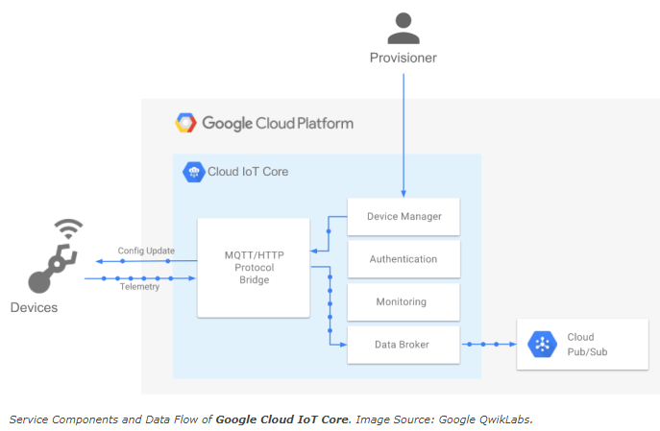
IoT jak źródło danych do zastosowań ML/AI - wsparcie rozwiązań chmurowych
Google Cloud IoT Core?
Google Cloud IoT Core - w pełni zarządzana usługa, która umożliwia łatwe i bezpieczne łączenie, zarządzanie i pozyskiwanie danych z milionów urządzeń rozproszonych po całym świecie.
Cloud IoT Core, w połączeniu z innymi usługami na platformie Google Cloud IoT - kompletne rozwiązanie do zbierania, przetwarzania, analizowania i wizualizacji danych IoT w czasie rzeczywistym wspierające wysoką wydajność operacyjną.
Notes:
What is Google Cloud IoT Core?
Google Cloud IoT Core is a fully managed service that allows you to easily and securely connect, manage, and ingest data from millions of globally dispersed devices.
Cloud IoT Core, in combination with other services on the Google Cloud IoT platform, provides a complete solution for collecting, processing, analyzing, and visualizing IoT data in real-time to support improved operational efficiency.

Slide 10
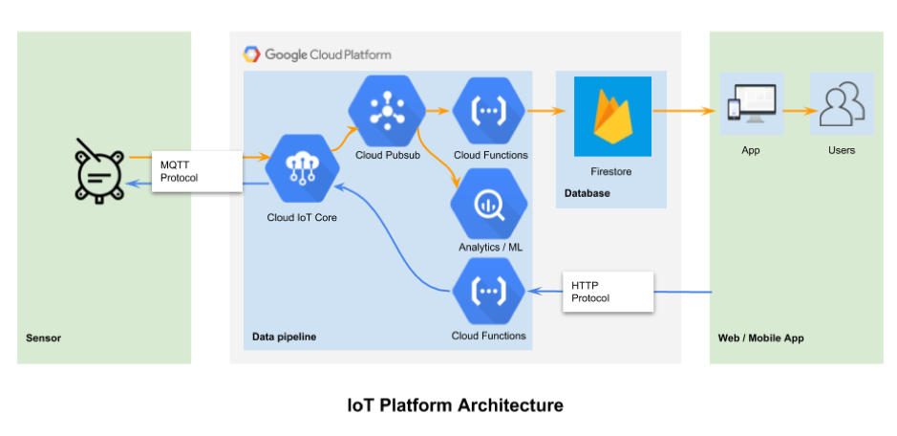
IoT jak źródło danych do zastosowań ML/AI - wsparcie rozwiązań chmurowych
Elementy Google Cloud w obsłudze IoT

Slide 11
IoT jak źródło danych do zastosowań ML/AI - wsparcie rozwiązań chmurowych
Sprzęt/sensor — przykład - Raspberry Pi z systemem RaspbianOS jako systemem operacyjnym czujnika. Google oferuje uproszczoną wersję Androida dla urządzeń IoT o nazwie „Android Things”. Android Things umożliwia programistom konfigurowanie i udostępnianie bezprzewodowo aktualizacji oprogramowania do systemu operacyjnego i aplikacji na urządzeniach za pośrednictwem wywołania interfejsu API.
Cloud IoT Core — bezserwerowa platforma umożliwiająca rejestrację urządzeń i zbieranie danych dla urządzeń IoT. Usługa wykonuje automatyczne równoważenie obciążenia i skaluje w celu obsługi pozyskiwania danych z milionów urządzeń. Urządzenia komunikują się z brokerem MQTT, który publikuje dane w Google Pub/Sub. IoT Core jest odpowiednikiem podobnych usług oferowanych przez AWS i Microsoft Azure.
Notes:
Hardware – The customer chose to go with a Raspberry Pi 3 running RaspbianOS as the sensor operating system. Google offers a stripped-down version of Android for IoT devices called “Android Things.” Android Things lets developers configure and push over-the-air software updates to the operating system and applications on devices via an API call.
Cloud IoT Core – Cloud IoT Core is a serverless platform that enables device enrollment and data collection for IoT devices. The service performs auto-load balancing and scales to support data ingestion from millions of devices. Devices communicate with an MQTT broker that publishes data to Google Pub/Sub. IoT Core is equivalent to similar services offered by AWS and Microsoft Azure.

Slide 12
IoT jak źródło danych do zastosowań ML/AI - wsparcie rozwiązań chmurowych
Pub/Sub — kolejka wiadomości w chmurze o dużej niezawodności. Umożliwia skalowanie obsługujące skoki ilości danych w sytuacji, gdy wiele urządzeń jednocześnie reaguje na zdarzenia w świecie fizycznym. Nie wymaga żadnej infrastruktury. Każde urządzenie wysyła dane i identyfikator urządzenia do kanału Pub/Sub (zdarzenia). Każda aplikacja, która musi odczytywać dane z urządzeń, może teraz subskrybować jeden kanał, aby odbierać wszystkie dane.
Cloud Functions — gdy dane wejdą do Pub/Sub, można je skierować do miejsca docelowego za pomocą Cloud Functions. Funkcja Cloud Functions to kod JavaScript, który jest uruchamiany w przypadku wystąpienia zdarzeń. Kod działa bez konieczności zarządzania infrastrukturą (w pełni zarządzany przez Google). Napisałem funkcję, która reaguje na przychodzące dane i zapisuje je do bazy dokumentów o nazwie FireStore oraz do BigQuery.
Notes:
Pub/Sub – Pub/Sub is a messaging queue in the cloud with strong reliability. It can scale to handle spikes in data volume when many devices simultaneously respond to events in the physical world and it requires absolutely no infrastructure. Each device sends data points and a deviceID to a Pub/Sub channel (events). Any application that needs to read data from devices can now subscribe to a single channel to receive all the data.
Cloud Functions – Once data enters Pub/Sub, it can be routed to its final destination using Cloud Functions. A Cloud Function is javascript code that is triggered to execute when events occur. The code runs without the need for infrastructure management (fully managed by Google). I wrote a function that reacts to incoming data and writes it to a document database called FireStore as well as to BigQuery.

Slide 13
IoT jak źródło danych do zastosowań ML/AI - wsparcie rozwiązań chmurowych
Przykładowe funkcje
Utworzenie tematu Pub/Sub z wykorzystaniem polecenia gcloud:
gcloud pubsub topics create tour-pub --project="${DEVSHELL_PROJECT_ID:-Cloud Shell}"
gcloud pubsub subscriptions create tour-sub --topic=tour-pub
Utworzenie rejestru urządzeń w chmurze IoT za pomocą polecenia gcloud:
gcloud iot registries create tour-registry \
--region=us-central1 --event-notification-config=topic=tour-pub
Rejestracja urządzenie przy użyciu klucza publicznego:
gcloud iot devices create test-dev --region=us-central1 \
--registry=tour-registry \
--public-key path=rsa_public.pem,type=rs256
Notes:
Hardware – The customer chose to go with a Raspberry Pi 3 running RaspbianOS as the sensor operating system. Google offers a stripped-down version of Android for IoT devices called “Android Things.” Android Things lets developers configure and push over-the-air software updates to the operating system and applications on devices via an API call.
Cloud IoT Core – Cloud IoT Core is a serverless platform that enables device enrollment and data collection for IoT devices. The service performs auto-load balancing and scales to support data ingestion from millions of devices. Devices communicate with an MQTT broker that publishes data to Google Pub/Sub. IoT Core is equivalent to similar services offered by AWS and Microsoft Azure.

Slide 14
IoT jak źródło danych do zastosowań ML/AI - wsparcie rozwiązań chmurowych
BigQuery – bezserwerowa, w pełni zarządzana hurtownia danych Google, która może uruchamiać zapytania SQL na terabajtach danych w ciągu kilku sekund. Korzystanie z BigQuery pozwala analitykom danych zadawać pytania dotyczące terabajtów danych bez konieczności wdrażania klastrów Hadoop i zarządzania nimi, przy rozsądnych kosztach.
Cloud Machine Learning — po zebraniu wystarczającej ilości danych - możliwe zastosowanie Cloud ML i Tensorflow do trenowania modeli potrzebnych w infrastrukturze hostowanej w chmurze. Po wyuczeniu modele można łatwo wyeksportować i uruchomić w innym miejscu.
Notes:
BigQuery – BigQuery is Google’s serverless, fully managed data warehouse that can run SQL like queries against terabytes of data in seconds. Using BigQuery allows the customers’ data scientists to ask questions against terabytes of data without needing to deploy and manage Hadoop clusters and at very reasonable costs.
Cloud Machine Learning – Once we collect enough data, my team plans to use Cloud ML and Tensorflow to train the models the customer needs on cloud hosted infrastructure. Once trained, the models can be easily exported to run elsewhere. Google offers a free crash course if you are a beginner to machine learning.

Slide 15
IoT jak źródło danych do zastosowań ML/AI - wsparcie rozwiązań chmurowych
Firebase Firestore — baza danych obsługującej zapytania uwzględniające lokalizację w czasie rzeczywistym. Jest to baza danych dokumentów NoSQL. Pokemon Go został zbudowany na poprzedniku Firestore o nazwie Datastore. Jest dostarczany z zestawami dla programistów (SDK) dla większości języków programowania i jest łatwy w tworzeniu.
Hosting Firebase — w przypadku aplikacji internetowej możliwe wykorzystanie frameworku Vue.js. Skompilowany kod aplikacji wdrożony na hostingu Firebase, który buforuje pliki aplikacji na serwerach brzegowych na całym świecie. Oznacza to szybkie czasy ładowania, niezależnie od lokalizacji użytkownika.
Notes:
Firebase Firestore – When you need a database that supports location aware queries in real time, look no further than Firestore. It is a NoSQL document database. Pokemon Go was built on a predecessor of Firestore called Datastore. It comes with software developer kits (SDKs) for most programming languages and is really easy to develop with.
Firebase Hosting – For the web app, my team used the Vue.js framework. The compiled application code was deployed to Firebase hosting which caches application files on edge servers all over the world. This means blazing fast load times, regardless of user location.

Slide 16
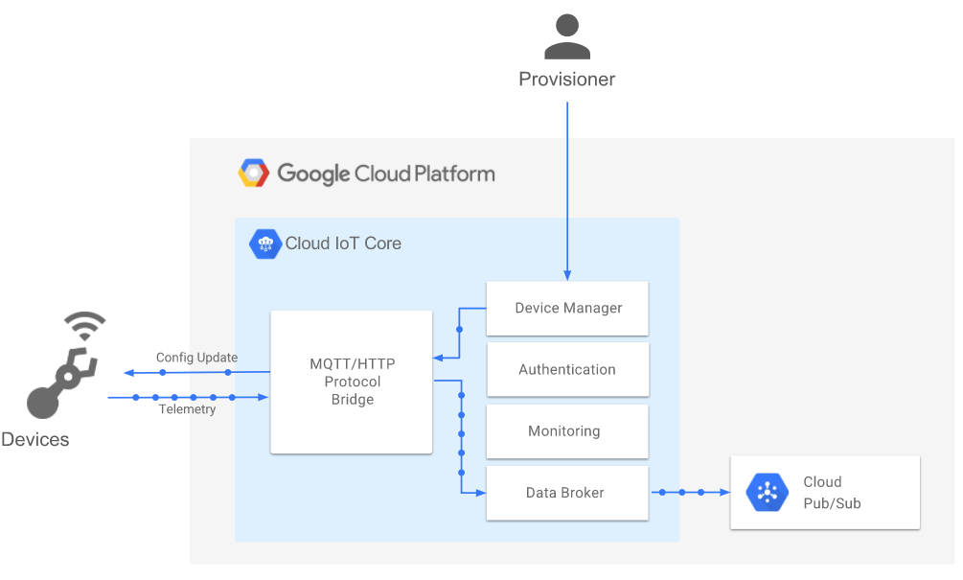
IoT jak źródło danych do zastosowań ML/AI - wsparcie rozwiązań chmurowych
Google IoT Core
Notes:
Elementy IoT Core
Device manager - maintains registries of devices as maned logical resources, protects this entries with IAM permissions, associates devices credentials with these resources, act as identity provider for MQTT brkoer, provides storage and delivery API for device configurations, mainstains some operational state metadata for device: enabled/disabled, connectivity and error status
MQTT broker: provides a stateful socket connection to devices for bidirectional communication, brokers device->cloud telemetry data onto Coud Pub/Sub for use in downstream GCP products or customer applications, delivers configuration updates via a Device Manager API, it exposes through a global DNS endpoint over multiple ports

Slide 17
IoT jak źródło danych do zastosowań ML/AI - wsparcie rozwiązań chmurowych
Elementy IoT Core
Menedżer urządzeń - utrzymuje rejestry urządzeń jako zarządzane zasoby logiczne, chroni te wpisy uprawnieniami IAM, kojarzy dane uwierzytelniające urządzenia z tymi zasobami, działa jako dostawca tożsamości dla brokera MQTT, zapewnia API przechowywania i dostarczania konfiguracji urządzeń, utrzymuje niektóre metadane stanu operacyjnego urządzenia : włączony/wyłączony, stan łączności i błędu
Broker MQTT - zapewnia stanowe (stateful) połączenie gniazda (socket) z urządzeniami do komunikacji dwukierunkowej, pośredniczy w przekazywaniu danych telemetrycznych urządzenia->chmury na Cloud Pub/Sub do użytku w produktach GCP lub aplikacjach klienta, dostarcza aktualizacje konfiguracji za pośrednictwem interfejsu API Menedżera Urządzeń, wystawia za pośrednictwem globalnego DNS endpoint na wielu portach
Notes:
Elementy IoT Core
Device manager - maintains registries of devices as maned logical resources, protects this entries with IAM permissions, associates devices credentials with these resources, act as identity provider for MQTT brkoer, provides storage and delivery API for device configurations, mainstains some operational state metadata for device: enabled/disabled, connectivity and error status
MQTT broker: provides a stateful socket connection to devices for bidirectional communication, brokers device->cloud telemetry data onto Coud Pub/Sub for use in downstream GCP products or customer applications, delivers configuration updates via a Device Manager API, it exposes through a global DNS endpoint over multiple ports

Slide 18
IoT jak źródło danych do zastosowań ML/AI - wsparcie rozwiązań chmurowych
Protokół MQTT
MQTT to protokół komunikacji typu maszyna-maszyna (M2M) dla „Internetu Rzeczy”. Zaprojektowany jako lekkie rozwiązanie typu publikuj/subskrybuj do transportu wiadomości
Pierwotnie opracowany w IBM w 1999 roku i zaprojektowany dla urządzeń z ograniczeniami
Obecnie - ratyfikowany standard
Protokół binarny efektywnie wykorzystujący przepustowość sieci bezprzewodowej
Prosty we wdrożeniu i wiele dostępnych bibliotek
Wspólny i de-facto standard stosowany w projektach IoT
Notes:
MQTT is a machine-to-macine (M2M) “Internet of Things” connectivity protocol. It was designed as an lightweight publish/subscribe messaging transport
Originally developed at IBM in 1999 and designed for constrained devices
Now - ratified standard
Binary protocol making efficient use of over-the-wire bandwidth
Simple to implement and many libraries available
Common and d-fact standard used in IoT projects

Slide 19
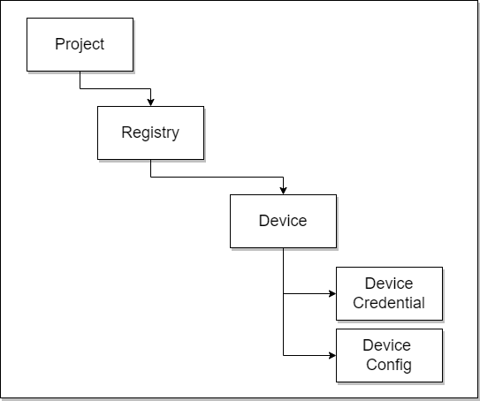
IoT jak źródło danych do zastosowań ML/AI - wsparcie rozwiązań chmurowych
Device Manager - model zasobów
menedżer urządzeń wspomaga organizację zasobów w chmurze do obsługi zarządzania urządzeniami

Slide 20
IoT jak źródło danych do zastosowań ML/AI - wsparcie rozwiązań chmurowych
Elementy Google Cloud w obsłudze IoT
KOLEJNY
WYKŁAD

Slide 21
Dziękuję za uwagę
Arkadiusz Harasimiuk

